Slide 1
Predicting Professional Athlete Career Lifetimes with Machine Learning
Alyssa Allende Motz, Matthew DeYoung,
Shihab Humayun, Peter Nielson

Slide 2
Summary of Selected Topic
Our selected topic is on if we can determine the length of a professional athlete's career based on external factors, including the sport they play, their position, height, weight, and more!

Slide 3
Why We Chose This Topic
We selected this topic because we think there is a lot of potential knowledge in the comparison of career length between each sport, position, and body type. It has the potential to be of use in a ‘real-world’ context: being able to predict an athlete’s career length could be of use to team managers, recruiters and fans alike!

Slide 4
Questions We Hope to Answer
The main question we hope to answer is: can we predict how long a given professional athlete’s career will last based upon some input parameters (eg position, body type, location and more)
We may also be able to answer what if any, factors have the largest influence on career length
We will also be answering whether the answer to our main question is general or sport specific by looking at data from four different types of professional sports

Slide 5
Source Data
We have found four adequate sources of data for professional football, hockey, basketball and baseball.
NFL: (https://www.kaggle.com/kendallgillies/nflstatistics)
The dataset contains data of players past and up to 2017. Initial cleaning of the data in Excel remove the extra characters from the Experience column to reflect just the number of seasons.
NHL: (NHL Player Stats 2004 - 2018 | Kaggle)
This dataset contains regular and "advanced" statistics for all NHL skaters from the 2004 through the 2018 season.
NBA: (https://www.kaggle.com/drgilermo/nba-players-stats)
The data-set contains aggregate individual statistics for 67 NBA seasons.
MLB: (Download Lahman’s Baseball Database – SeanLahman.com)
Lahman’s data set contains complete batting and pitching statistics from 1871 to 2020, plus fielding statistics, standings, team stats, managerial records, post-season data, and more.
All of these data sets can be found in the ‘DataSets’ folder of our main repository.

Slide 6
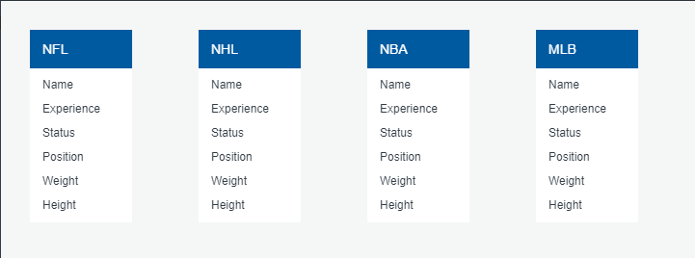
Provisional Database

Slide 7
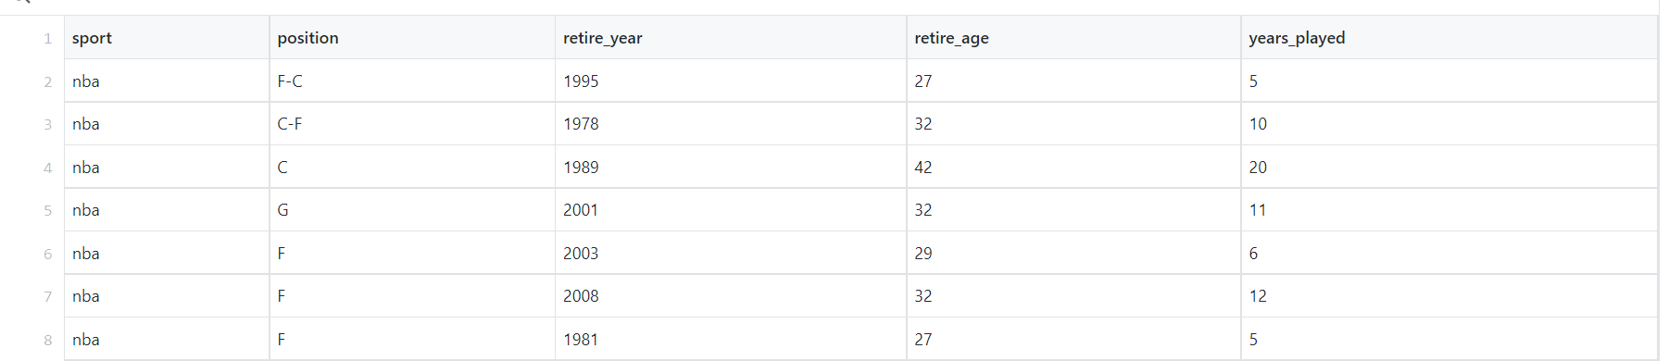
Provisional Database
Please see the ‘Deliverable 1’ repository for our provisional database. The file is named ‘layout alpha.csv’ and includes aggregate data from all 4 of our raw datasets combined with the following headings:

Slide 8
Machine Learning Model
Please see the MachineLearningSummary.md file in the ‘Deliverable 1’ folder for a more in-depth description of our approach.

